Slide 1
Sequential Models
RNN for NLP
Teaching Machines to Understand Sequences, Context, and Language

Slide 2
Contents
01
02
03
Sequential Data
Recurrent Neural Networks
LSTM
Understanding order-dependent information
Long Short-Term Memory and gating mechanisms
Memory-enabled architectures for sequences
04
05
Next Word Prediction
NLP Applications
End-to-end sequence modeling in practice
Real-world uses of sequential models

Slide 3

FOUNDATIONS
What Are Sequential Models?
Sequential models are designed for data where order matters and each element depends on what came before it. Unlike static inputs, sequential data carries temporal or structural dependencies that must be preserved during processing.
Sentences
Speech
"I love NLP" ≠ "NLP love I" — word order defines meaning
Sound waves unfold over time with context-sensitive phonemes
Time Series
DNA Sequences
Stock prices, sensor readings — past values predict future ones
Biological patterns encoded in ordered nucleotide chains
Core Goal: Learn patterns and dependencies across ordered sequences — not just within individual elements.

Slide 4

MOTIVATION
Why Traditional Neural Networks Fail at NLP
Standard Feedforward Network
What Language Actually Requires
Each word is treated as a completely independent input. There is no mechanism to pass information between time steps. The words "I", "love", and "NLP" are processed in isolation — the network has no idea they form a coherent sentence.
Understanding of word order and grammar
Memory of earlier words to interpret later ones
Context propagation across the full sentence
Variable-length input handling
Language is inherently contextual and temporal. A model that forgets the beginning of a sentence before it reaches the end cannot understand meaning.
No memory. No context. No sequence awareness.

Slide 5

CORE CONCEPT
Recurrent Neural Networks (RNN)
An RNN is a neural network architecture specifically designed to process sequential data by maintaining a hidden state — an internal memory that is updated at each time step and passed forward through the sequence.
One Word at a Time
Hidden State as Memory
Recurrent Loop
The network processes each token sequentially, step by step
Previous output feeds back into the network as contextual memory
The same weights are applied at every step — weight sharing across time
Key Insight: The current output depends on both the current input and the previous hidden state — this is what gives RNNs their memory.

Slide 6
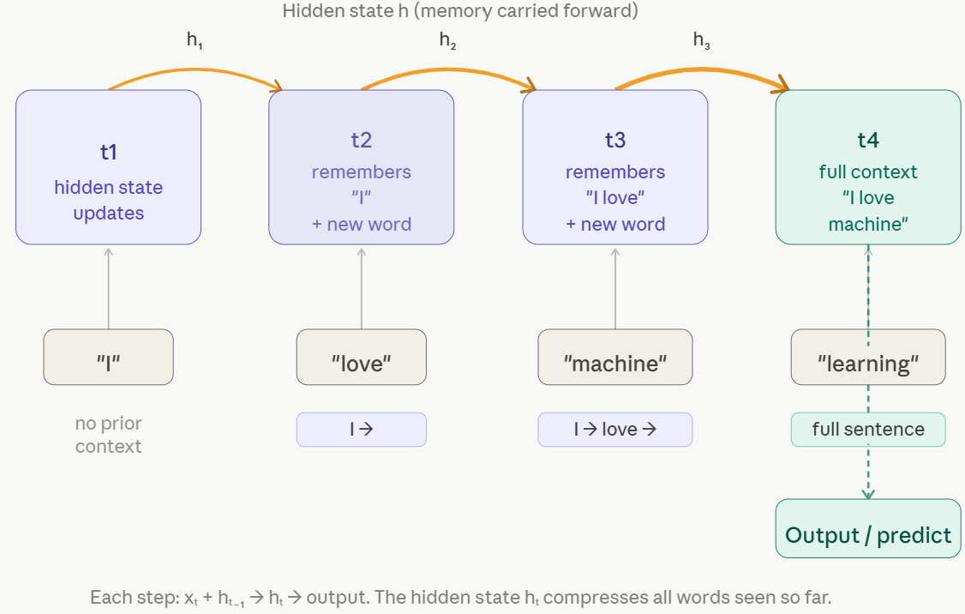
Working of an RNN — Step by Step
Consider the sentence "I love machine learning." The RNN processes one word at a time, updating its
hidden state (memory) at every step:
At each time step, the formula is: Input Word → Hidden State Update → Output. The hidden state carries a compressed representation of all previously seen words, enabling the network to generate context-aware predictions.

Slide 7

RNN Architecture & The Core Formula
Structural Components
The Recurrence Equation
hₜ = f(Wxₜ + Uhₜ₋₁)
Input Layer
Receives the current token xt as a vector
Where:
xt — current word input vector
hₜ₋₁ — previous hidden state (memory)
W — input weight matrix
U — recurrent weight matrix
hₜ — new hidden state after update
f — activation function (typically tanh)
Hidden State
Encodes memory from all prior time steps
Output Layer
Produces prediction or passes state forward
The same weights W and U are shared across every time step — this is called parameter sharing.

Slide 8




STRENGTHS
Advantages of RNNs
Sequence-Aware
Variable-Length Input
Preserves word order and captures the temporal structure of language that feedforward networks miss entirely
Handles sentences of any length without requiring fixed-size inputs — ideal for real-world text data
Contextual Learning
Broad NLP Coverage
Builds a running context from previous tokens, enabling meaningful predictions based on prior words
Powers language modeling, machine translation, chatbots, speech recognition, and text generation

Slide 9

LIMITATIONS
The Vanishing Gradient Problem
What Goes Wrong
A Concrete Example
During backpropagation through time (BPTT), gradients are multiplied repeatedly across time steps. For long sequences, these gradients shrink exponentially — effectively reaching zero before reaching the earliest time steps.
The result: the network cannot learn dependencies between words that are far apart.
"The movie which I watched with my friends last weekend was absolutely fantastic."
By the time the RNN reaches "absolutely fantastic", it has likely forgotten the original subject — "The movie". The gradient signal tracing back to that early token has vanished.
Subject-verb agreement breaks down
Long-range dependencies fail
Model performance degrades with sequence length
Early context is lost. The model forgets the beginning of long sentences before processing the end.

Slide 10

SOLUTION
Why LSTM Was Introduced
Long Short-Term Memory (LSTM), introduced by Hochreiter & Schmidhuber in 1997, was specifically engineered to address the vanishing gradient problem and extend the effective memory of recurrent networks.
Remember Longer
Forget Selectively
Stable Gradients
Retains important information across many time steps without degradation
Actively discards irrelevant information using a dedicated forget mechanism
Cell state design keeps gradient magnitudes stable during backpropagation
Key Advantage: LSTM introduces a cell state — a dedicated memory lane that runs through the entire sequence, protected by learned gating mechanisms.

Slide 11



ARCHITECTURE
LSTM Architecture — The Three Gates
At the heart of every LSTM cell are three learnable gates — sigmoid-activated controllers that determine what information flows through the cell state at each time step:
Forget Gate
Input Gate
Output Gate
Decides what to erase from the previous cell state. Outputs values between 0 (forget completely) and 1 (keep entirely)
Decides what new information to write into the cell state, combining current input with prior hidden state
Decides what to expose as the hidden state output — the filtered representation passed to the next step
Together, these gates enable fine-grained control over memory — the network learns when to remember, when to forget, and what to share.

Slide 12

RNN vs. LSTM — Head-to-Head
Feature
RNN
LSTM
Memory Type
Short-term only
Short-term + Long-term
Long Sequence Handling
Degrades quickly
Handles well
Vanishing Gradient
Frequent problem
Significantly reduced
Architecture Complexity
Simple — one hidden state
Complex — cell state + 3 gates
Training Speed
Faster
Slower per step
NLP Performance
Moderate
Substantially better
Bottom Line: LSTM is the evolved form of RNN — more complex, but dramatically more capable for real-world language tasks.

Slide 13
Email Auto-Complete System
Objective
Key Idea
Build an Email Auto-Complete System
Predict the next characters in a sentence
Generate realistic email phrases automatically
Given previous text → what comes next?
Real-Life Example
What We Did
Input
Used common email phrases dataset
Converted text → numbers (character-level)
Trained an LSTM model to learn patterns
"kind "
Output
"kind regards"

Slide 14

Process Flow & Output
01
02
Data Preparation
Model Training (LSTM)
Text → characters → numbers. Padding applied for equal-length sequences.
Learns sequence patterns from data. Example: "thank" → "you".
03
04
Prediction (Auto-complete)
Temperature Control
Input seed text, then predict the next character step-by-step.
Low → safe & professional. High → creative & random.
Final Output Examples
"best " → "best regards"
"hope " → "hope you are doing well"
"many " → "many thanks"
💡 One-Line Summary: Train → Learn patterns → Predict next → Generate text

Slide 15




Applications & Key Takeaways
Real-World Applications
Summary
Conversational AI
NLP needs sequential models
RNN introduced memory
ChatGPT-style systems, virtual assistants, and chatbots
Language is order-dependent — standard networks can't capture this
Hidden state enables context propagation across a sequence
Machine Translation
Google Translate and sequence-to-sequence models
Speech Recognition
LSTM improved long-term learning
Foundation for modern NLP
Voice assistants, transcription, dictation systems
Gated cell state solves the vanishing gradient bottleneck
RNN/LSTM architectures underpin transformer-era breakthroughs
Text Generation
Autocomplete, summarization, predictive typing

